Slide 1

Rating Prediction Project
By
Gargi Saha Samanta

Slide 2

Content
Problem Statement
Data Summary
Data Preprocessing
Exploratory Data Analysis
Feature Engineering
Model Building with Classification techniques
Hypertuning the Best Model
Conclusion

Slide 3
Problem Statement
We have a client who has a website where people write different reviews for technical products.
Now they are adding a new feature to their website i.e. The reviewer will have to add stars(rating) as well with the review.
The rating is out 5 stars and it only has 5 options available 1 star, 2 stars, 3 stars, 4 stars, 5 stars.
Now they want to predict ratings for the reviews which were written in the past and they don’t have a rating.
So, we have to build an application which can predict the rating by seeing the review.

Slide 4

Data Summary
FEATURES:
Reviews of the product
Rating of the products

Slide 5
Data Preprocessing
Convert to lower
Replace email address
Replace web address
Replace money symbols
Replace 10 digit phone numbers (formats include paranthesis, spaces, no spaces, dashes) with 'phonenumber’
Replace numbers with 'numbr’
Finding the stopwords.
Applying lemmatization.
Analyzing of loud words with rating greater than 4 and less than 2.

Slide 6
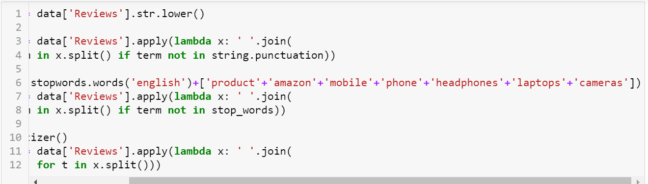
Data Preprocessing

Slide 7
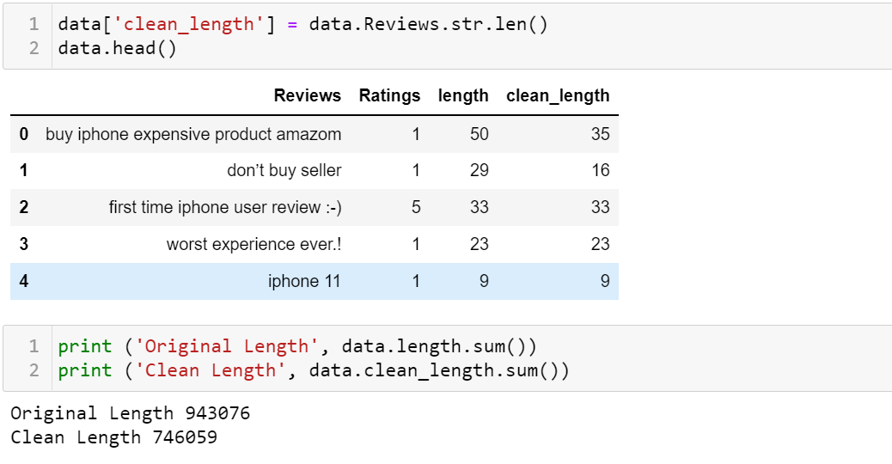

Slide 8
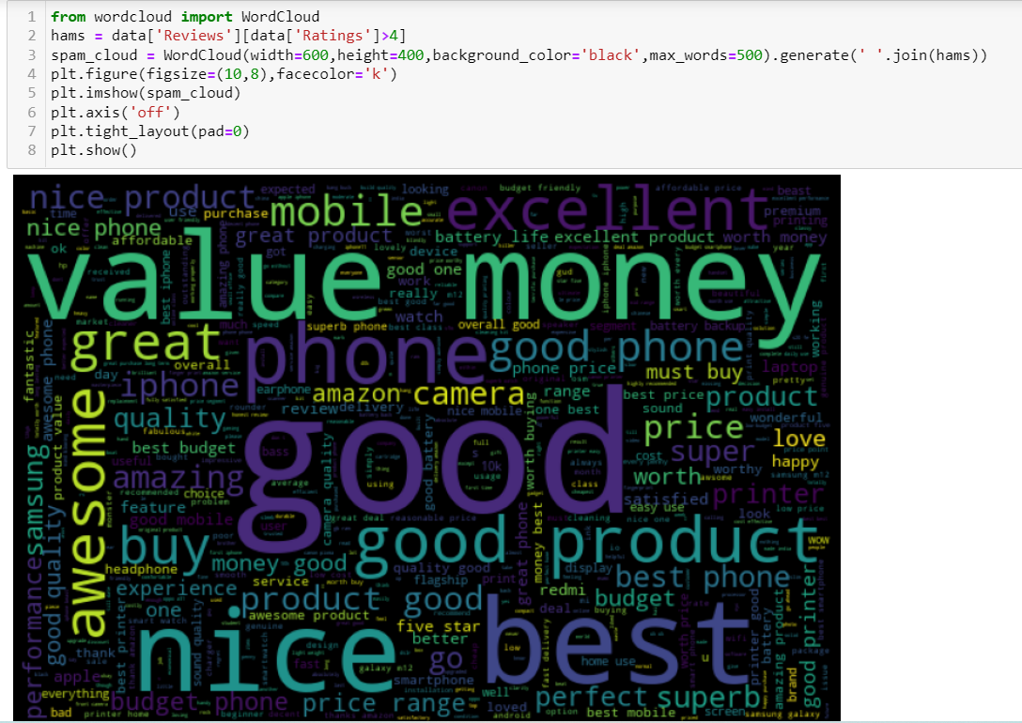
Dispalying the most prominent and frequent words having rating greater than 4

Slide 9
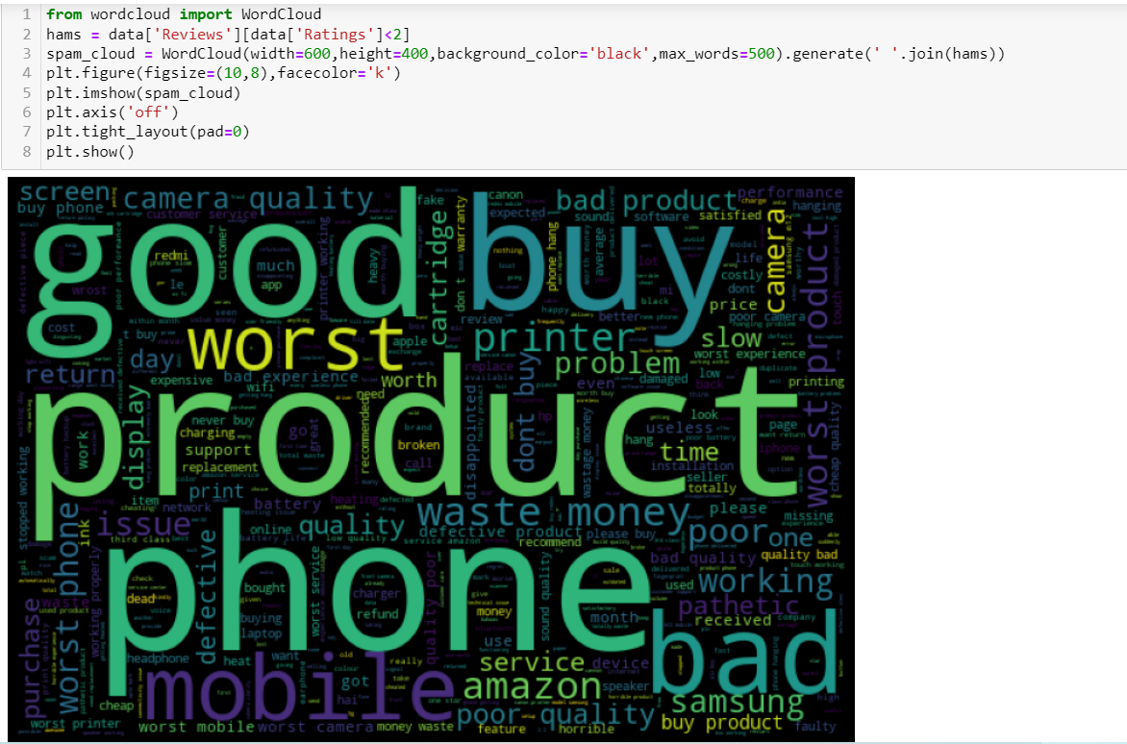
Dispalying the most prominent and frequent words having rating greater than 4

Slide 10
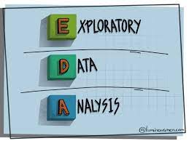
Exploratory Data Analysis ( EDA)

Slide 11
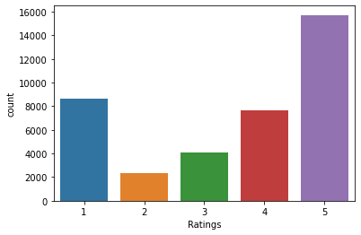
Distribution of Original Ratings:

Slide 12
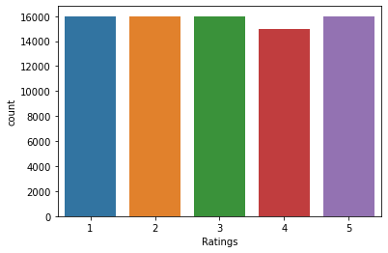
Distribution of Ratings after oversampling:

Slide 13
Models used:
LogisticRegression()
KNeighborsClassifier()
RandomForestClassifier()
DecisionTreeClassifier()

Slide 14
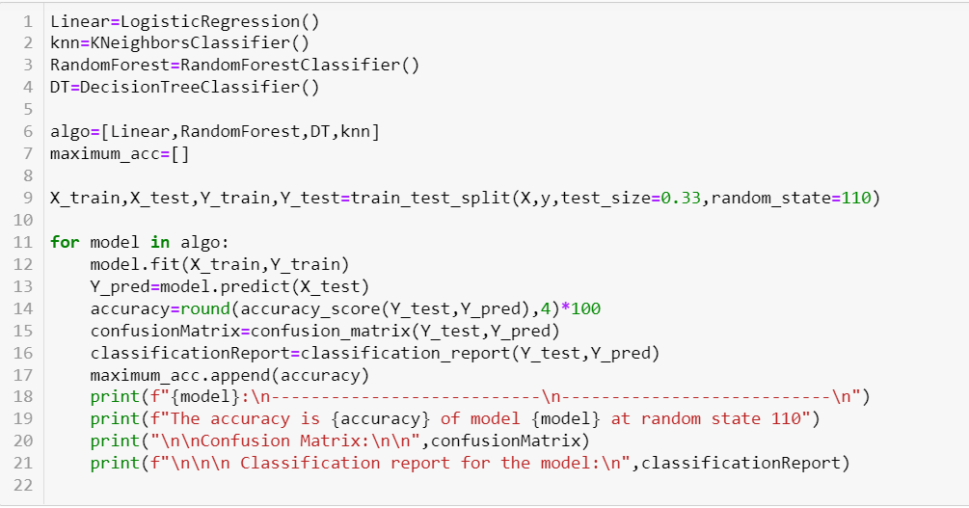
Model Building
From the dataset we can infer that it is clearly a Classification problem.

Slide 15
Accuracy of the Models:

Slide 16
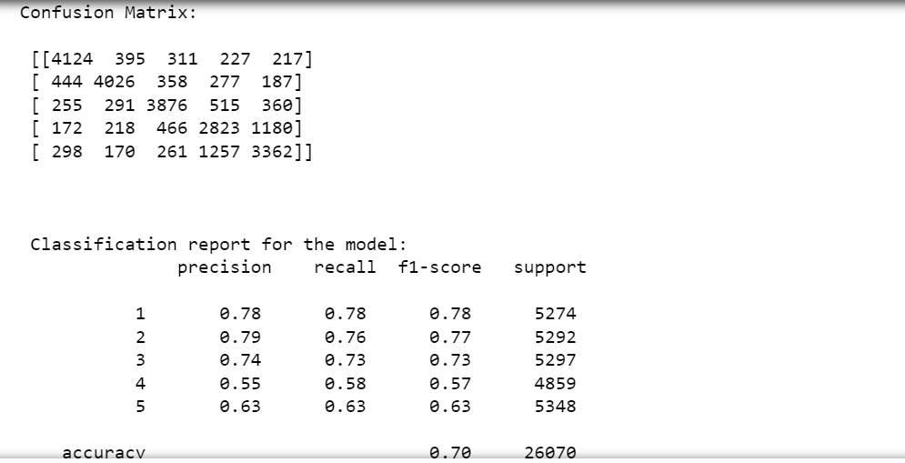
Accuracy of the Best Model (Random Forest Classifier)

Slide 17
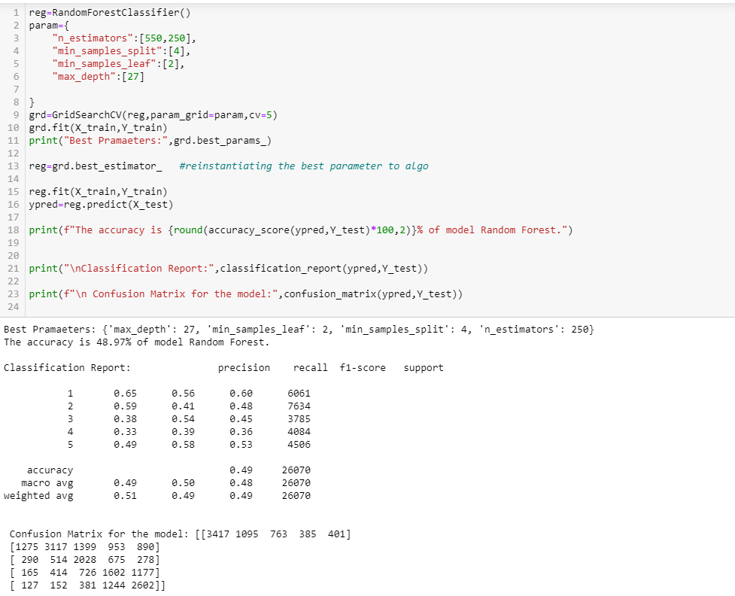
Hyper Tuning The Random Forest Model

Slide 18
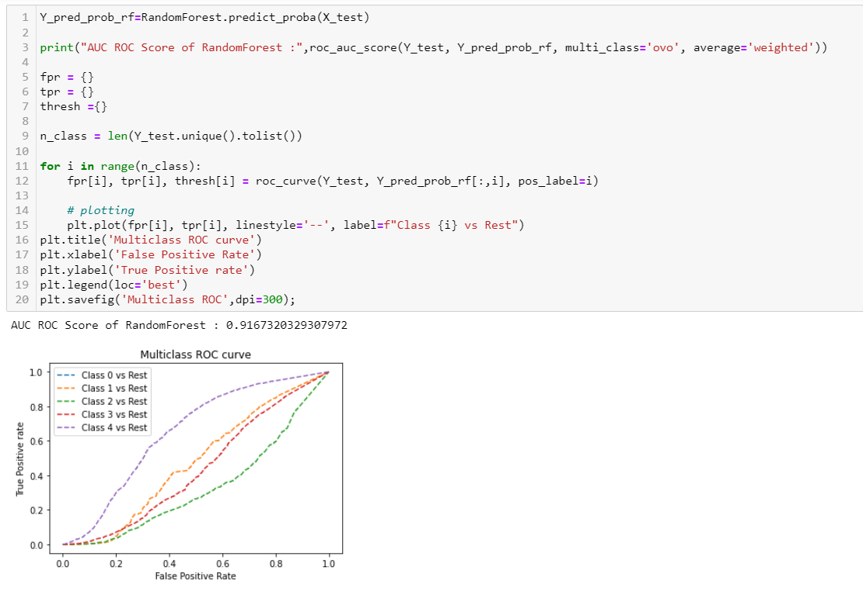
ROC _AUC CURVE

Slide 19
CONCLUSION
FINAL OBSERVATION:
As we have decrease in accuracy after hyper tuned.
So, it's better to use Random Forest with default parameters.
Finally we have saved the Random Forest Classifier Model.

Slide 20


